Slide 1
Implementation of distributed ML
Yue Wang

Slide 2
Implementation of distributed ML
Lock and lock-free
Partition data and sampling data
Share memory and parameter server
Under parameter server
Decentralize architecture

Slide 3
asynchronous
Share memory
Parameter server
Partition or sampling data
When to sync
Decentralize
Lock or lock-free

Slide 4
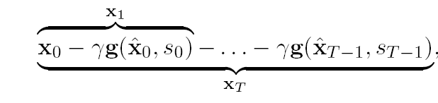

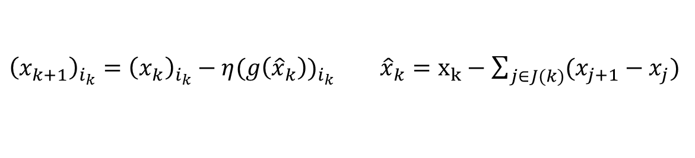

Lock and lock-free
$$x_{j+1}=x_{j}−ηg(x_{j−τ})$$
Consistent read
Inconsistent read
${\left(x_{k+1}\right)}_{i_{k}}={\left(x_{k}\right)}_{i_{k}}−η(g{\left({\hat{x}}_{k}\right))}_{i_{k}}$ ${\hat{x}}_{k}=x_{k}−\sum_{j∈J(k)}{(x_{j+1}−x_{j})}$
Recht, Benjamin, et al. "Hogwild: A lock-free approach to parallelizing stochastic gradient descent." Advances in Neural Information Processing Systems. 2011.
Lian, Xiangru, et al. "Asynchronous parallel stochastic gradient for nonconvex optimization." Advances in Neural Information Processing Systems. 2015.
Mania, Horia, et al. "Perturbed iterate analysis for asynchronous stochastic optimization." arXiv preprint arXiv:1507.06970 (2015).

Slide 5
Partition data and sampling data

Slide 6
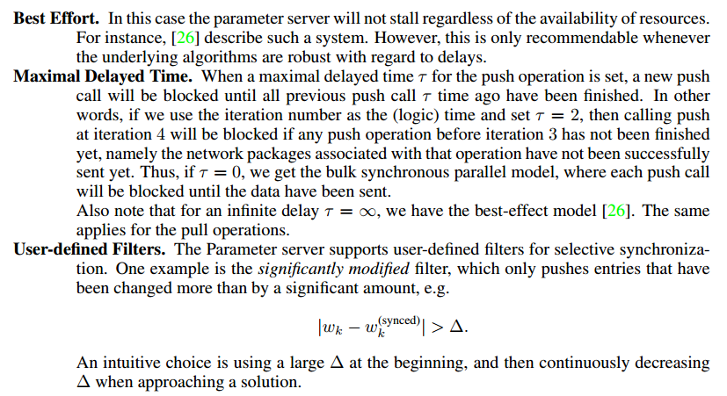

Parameter server
Both push and pull operations are non-blocking. The caller (typically the computational thread) inserts its requests into queues, and then resumes computation. Separate I/O threads managed by the framework perform the actual network communication
$$G_{i}\left(t\right)=∇f_{i}\left(ω\left(t_{i}\right)+σ_{ω}\left(t_{i}\right)\right)+{σ_{∇}}_{i} (t)$$

Slide 7
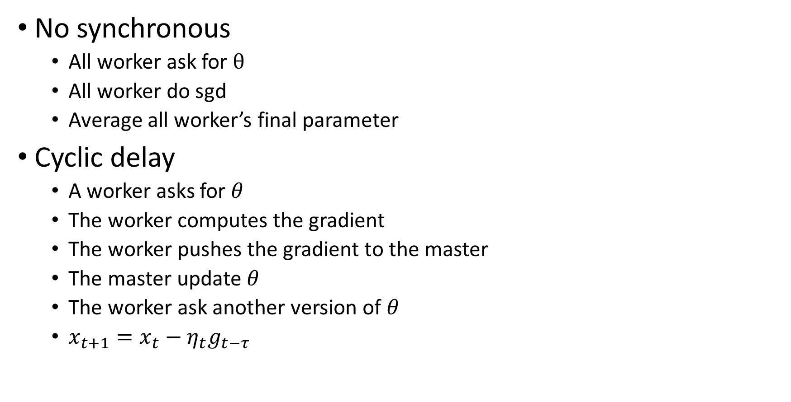
Under parameter server
No synchronous
All worker ask for $θ$
All worker do sgd
Average all worker’s final parameter
Cyclic delay
A worker asks for $θ$
The worker computes the gradient
The worker pushes the gradient to the master
The master update $θ$
The worker ask another version of $θ$
$x_{t+1}=x_{t}−η_{t}g_{t−τ}$

Slide 8
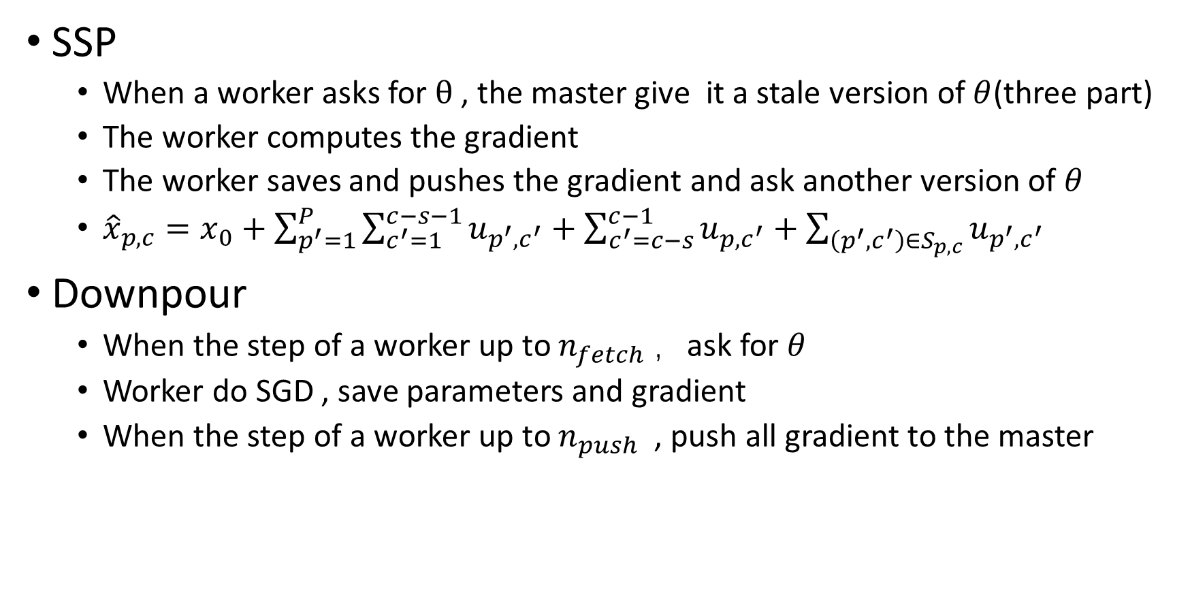
Under parameter server
SSP
When a worker asks for $θ$ , the master give it a stale version of $θ$(three part)
The worker computes the gradient
The worker saves and pushes the gradient and ask another version of $θ$
${\hat{x}}_{p,c}=x_{0}+\sum_{p^{′}=1}^{P}{\sum_{c^{′}=1}^{c−s−1}{u_{p^{′},c^{′}}}}+\sum_{c^{′}=c−s}^{c−1}{u_{p,c^{′}}}+\sum_{\left(p^{′},c^{′}\right)∈S_{p,c}}{u_{p^{′},c^{′}}}$
Downpour
When the step of a worker up to $n_{fetch}$ ，ask for $θ$
Worker do SGD , save parameters and gradient
When the step of a worker up to $n_{push}$ , push all gradient to the master

Slide 9
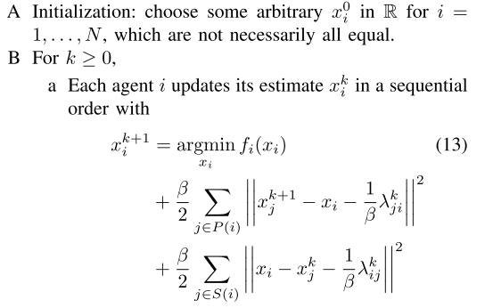
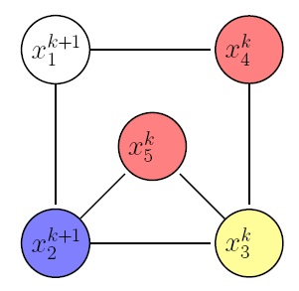
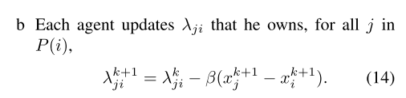
Decentralize

Slide 10
From optimization algorithm view

Slide 11
Assume
only a single coordinate per sampled hyperedge is updated (i.e.,the for loop in Hogwild! is replaced with a single coordinate update);
the authors assumed consistent reads, i.e., it was assumed that while a core is reading the shared variable, no writes from other cores occur;
the authors make an implicit assumption on the uniformity of the processing times of cores (explained in the following), that does not generically hold in practice

Slide 12
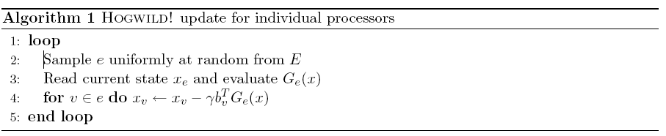
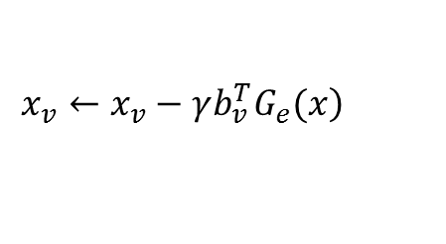
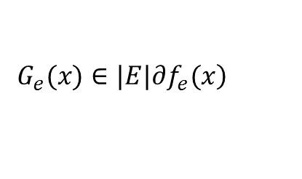
Lock and lock-free
$$\left.G_{e}(x)∈|E|∂f_{e}(x\right)$$
$$\left.x_{v}←x_{v}−γb_{v}^{T}G_{e}(x\right)$$
Assume
only a single coordinate per sampled hyperedge is updated (i.e.,the for loop in Hogwild! is replaced with a single coordinate update);
the authors assumed consistent reads, i.e., it was assumed that while a core is reading the shared variable, no writes from other cores occur;
the authors make an implicit assumption on the uniformity of the processing times of cores (explained in the following), that does not generically hold in practice

Slide 13
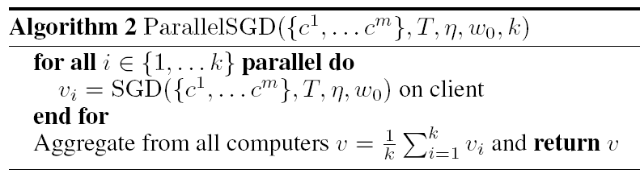
MapReduce framework

Slide 14
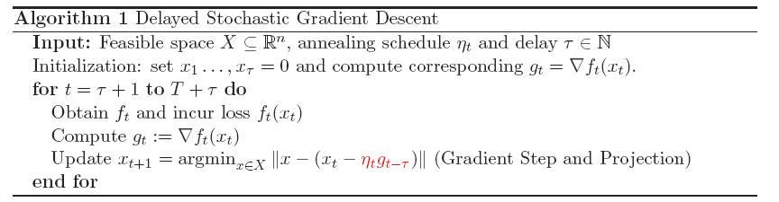
Lock
read / write-locking mechanism for x ,atomic updates on the parameter vector

Slide 15

$$p_{v}=b_{v}b_{v}^{T} G_{e}\left(x\right)=$$
Assume
only a single coordinate per sampled hyperedge is updated (i.e.,the for loop in Hogwild! is replaced with a single coordinate update);
the authors assumed consistent reads, i.e., it was assumed that while a core is reading the shared variable, no writes from other cores occur;
the authors make an implicit assumption on the uniformity of the processing times of cores (explained in the following), that does not generically hold in practice

Slide 16
original

Slide 17
downpour

Slide 18
ssp

Slide 19
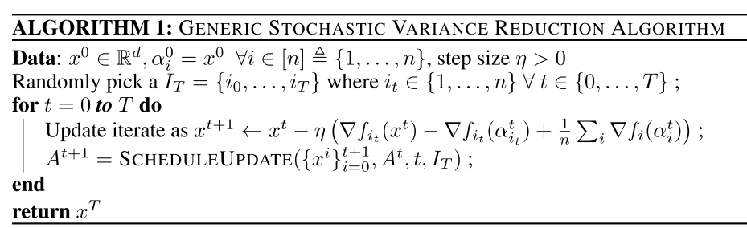
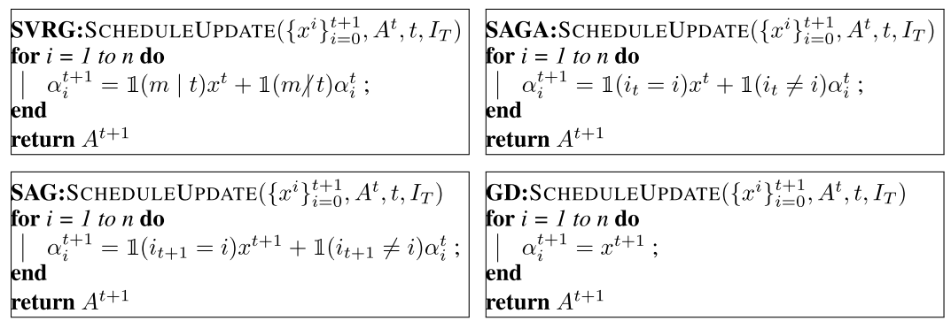

Slide 20
